Slide 1
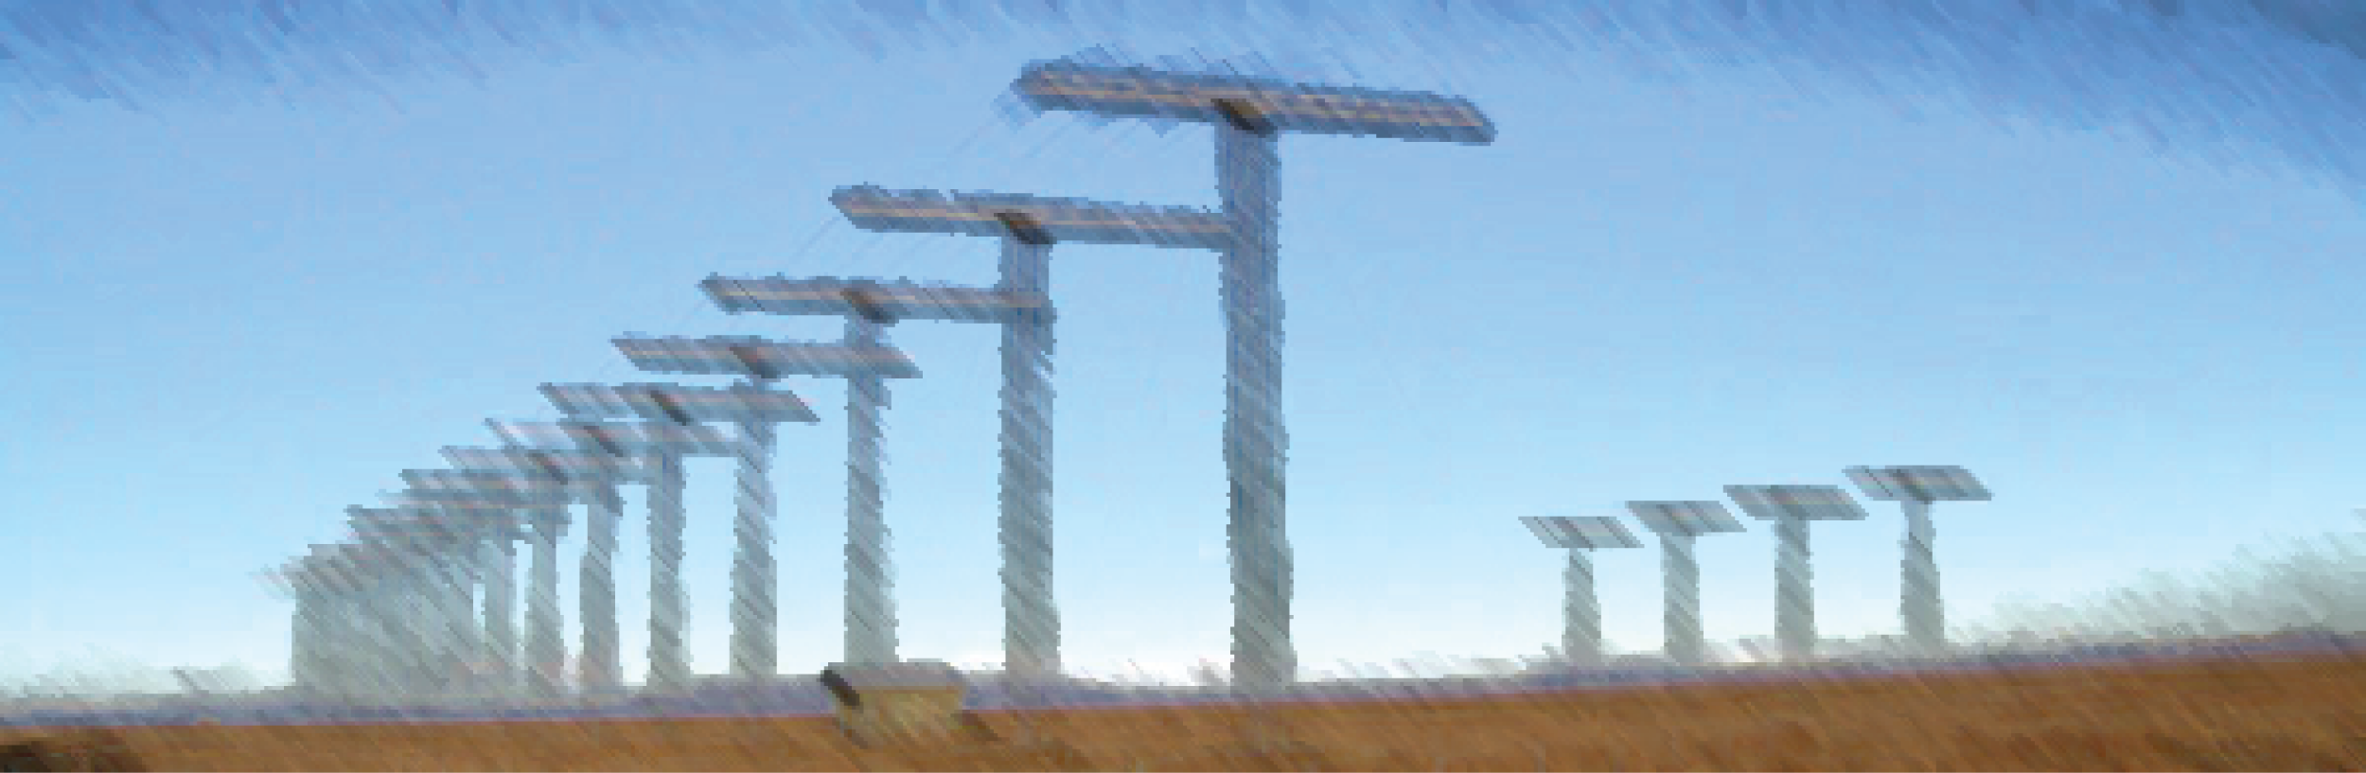

Upstream Pc3 ULF wave signatures observed near the Earth's cusp
Tim Yeoman
Darren Wright (Leicester)
Mark Engebretson, Fei Lu, and Jennifer Posch (Augsburg, USA);
Marc Lessard and Hyomin Kim (University of New Hampshire, USA)
SuperDARN Workshop, 2011

Slide 2
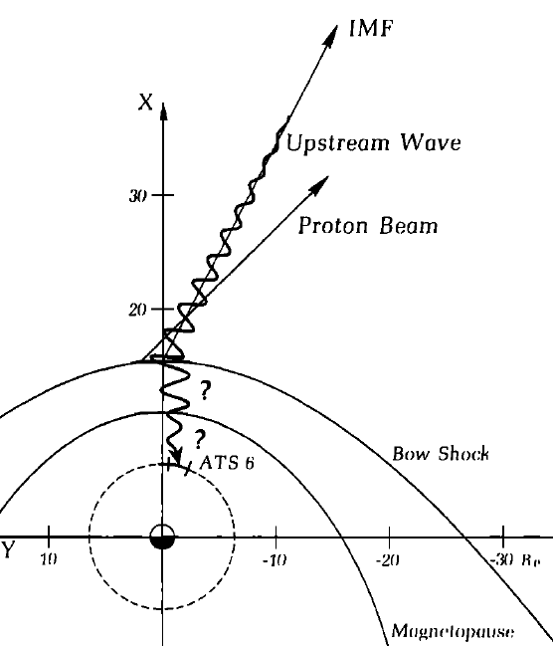
Gary, 1981
Takahashi, 1984

Slide 3
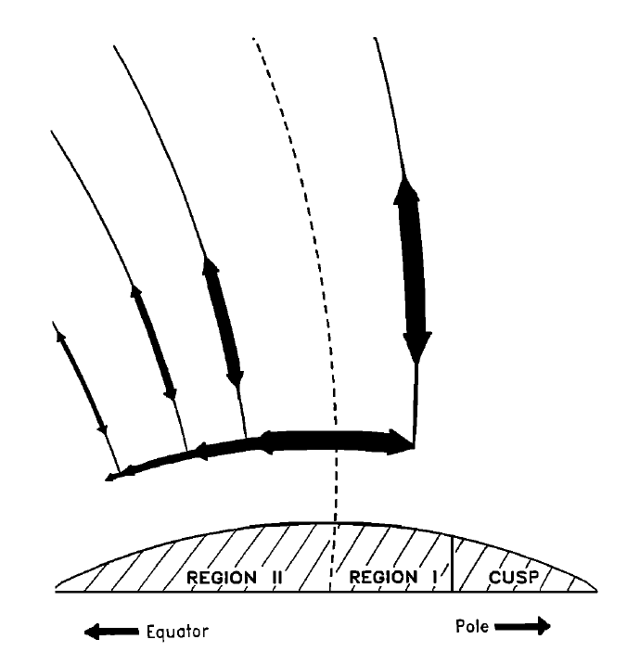
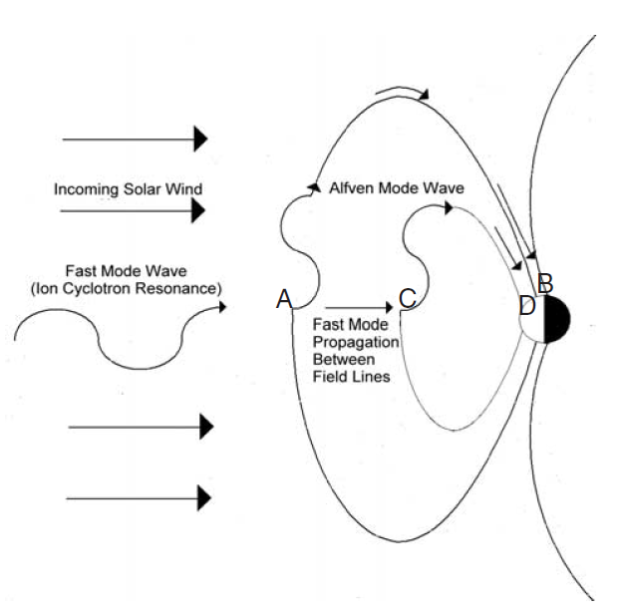
Howard and Menk, 2005
Engebretson et al., 2005

Slide 4
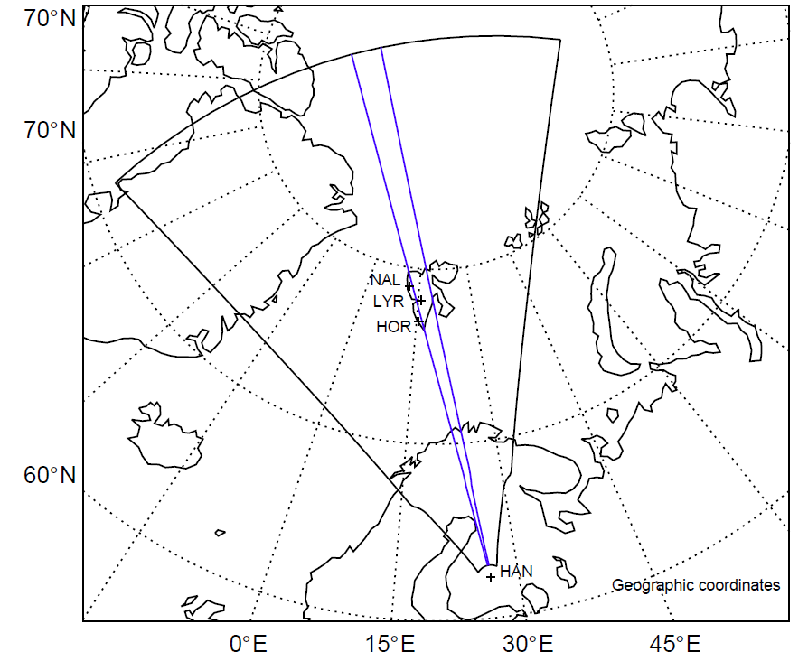
The Augsburg induction magnetometer array and the Hankasalmi radar

Slide 5
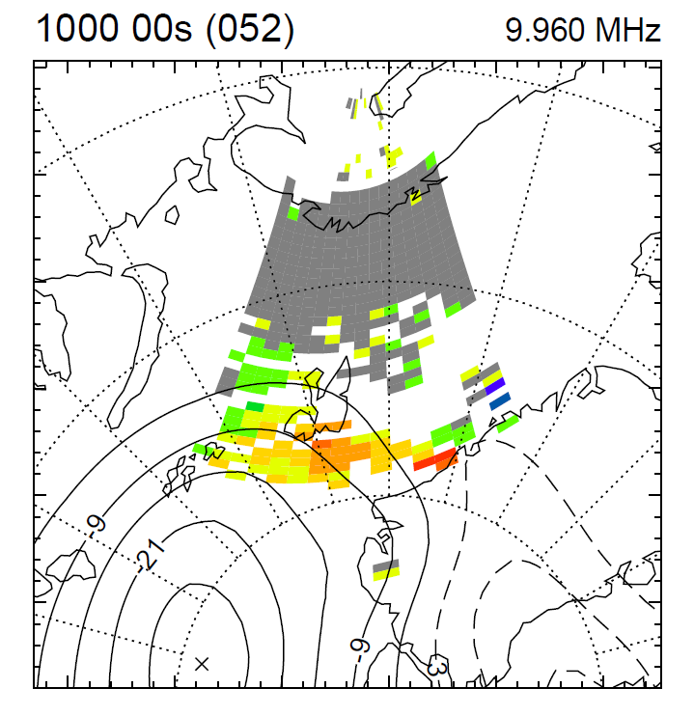
Intervals were selected with strong Pc3 activity, where the upstream ACE cone angle is conducive
to upstream wave generation, and good cusp data coverage is available from Hankasalmi, with high time resolution data on Channel B beam 9
21 Feb 2008

Slide 6
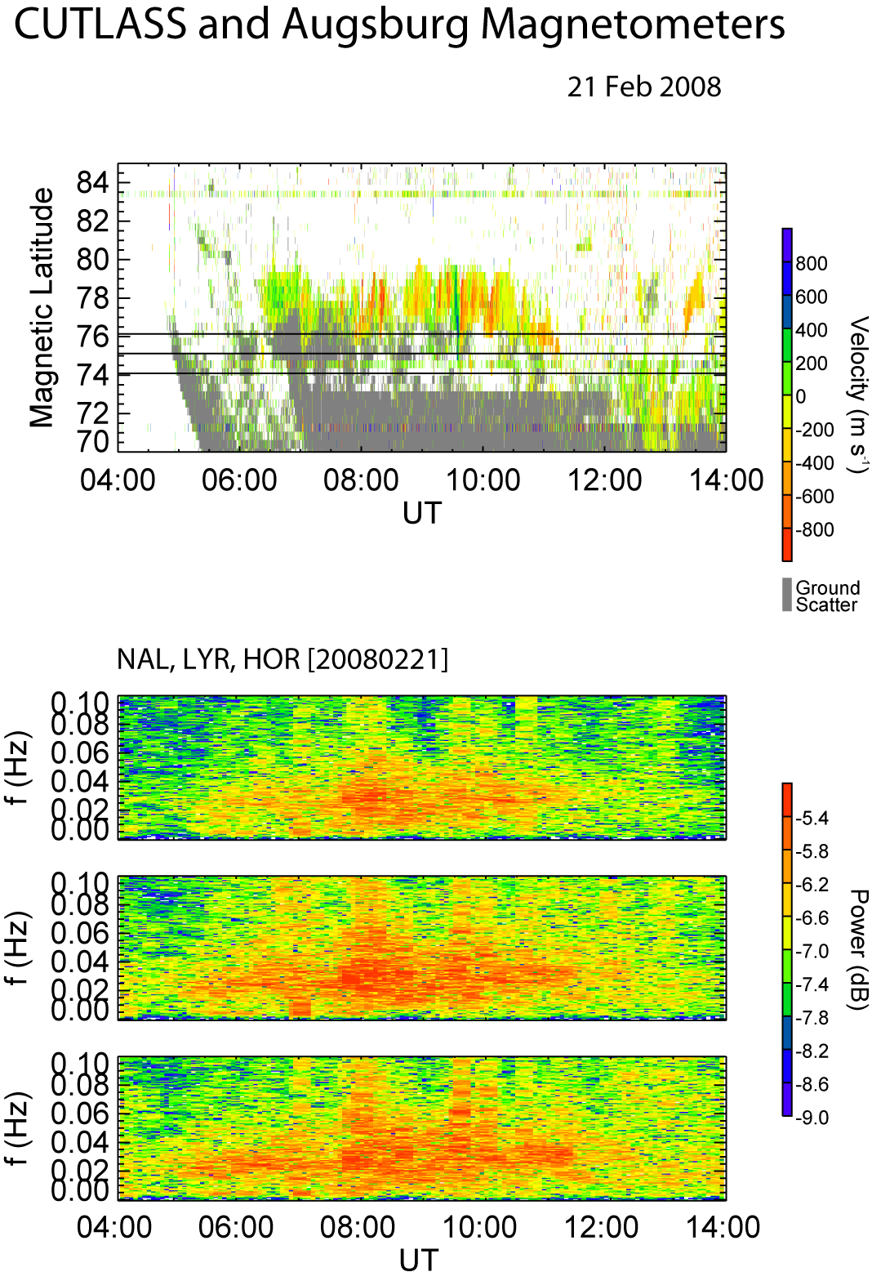
Hankasalmi Channel B data: Beam 9, 3 s sampling
NAL
LYR
HOR
2 Hz sampled induction coil data
FFT length 20 min, 5 min slip

Slide 7
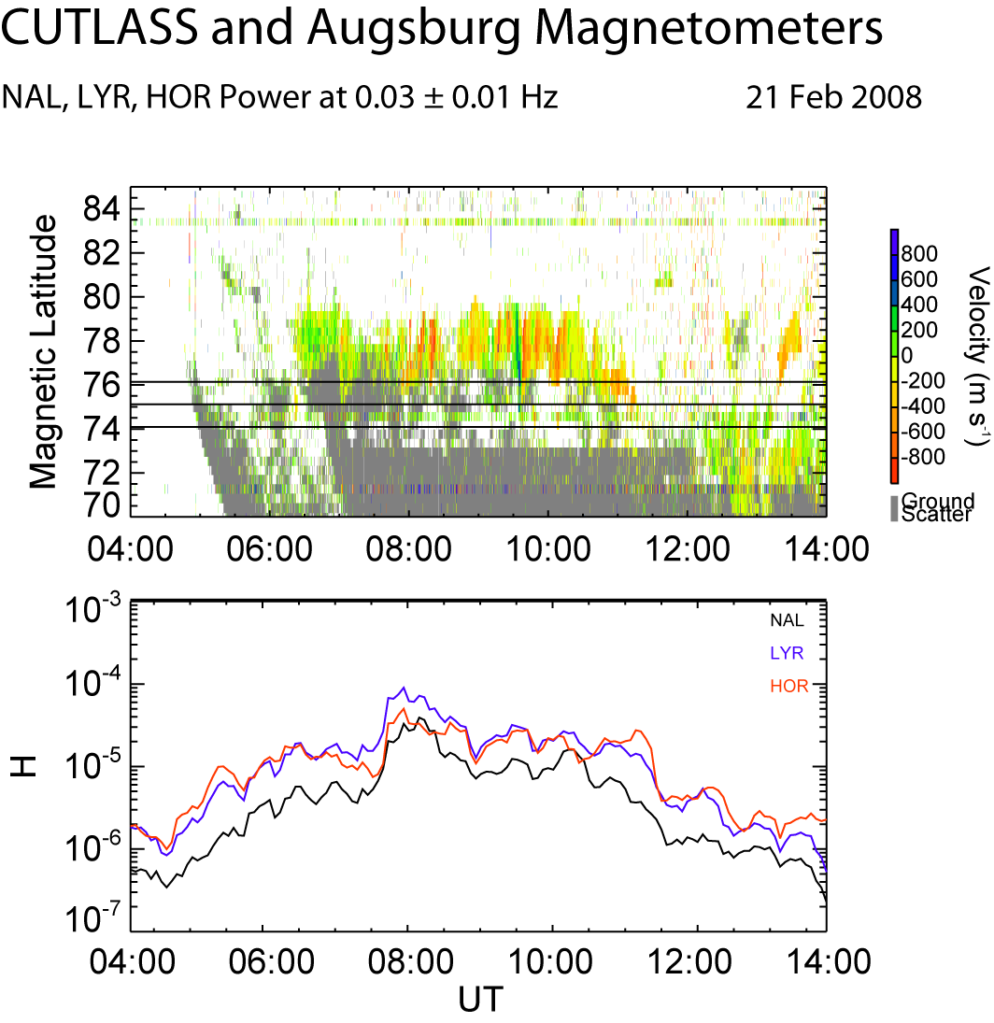
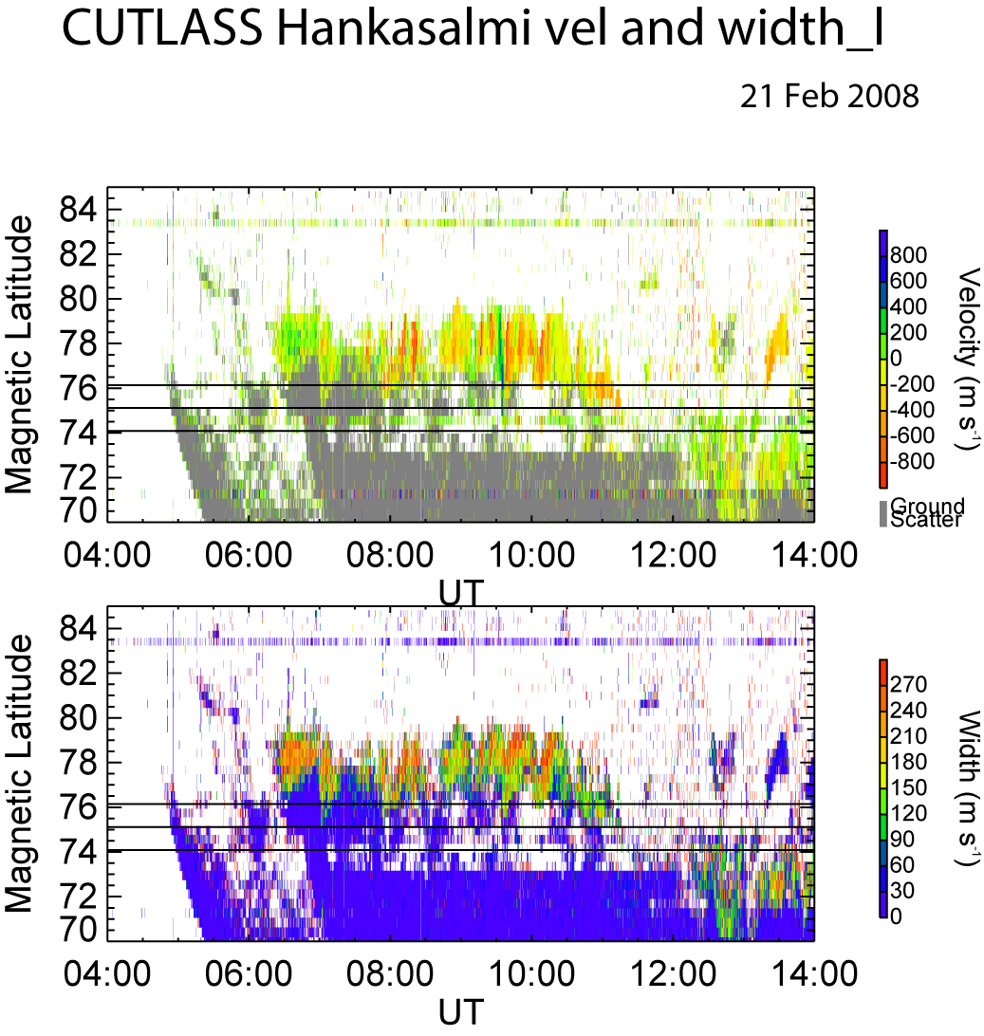
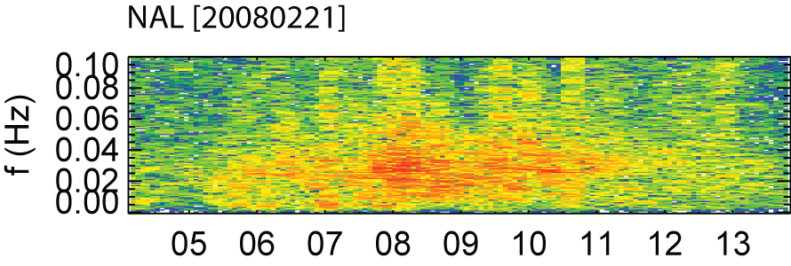
Identify the cusp:
Width >200 m s⁻¹
5 min average
Sum wave power between 20 and 40 mHz

Slide 8
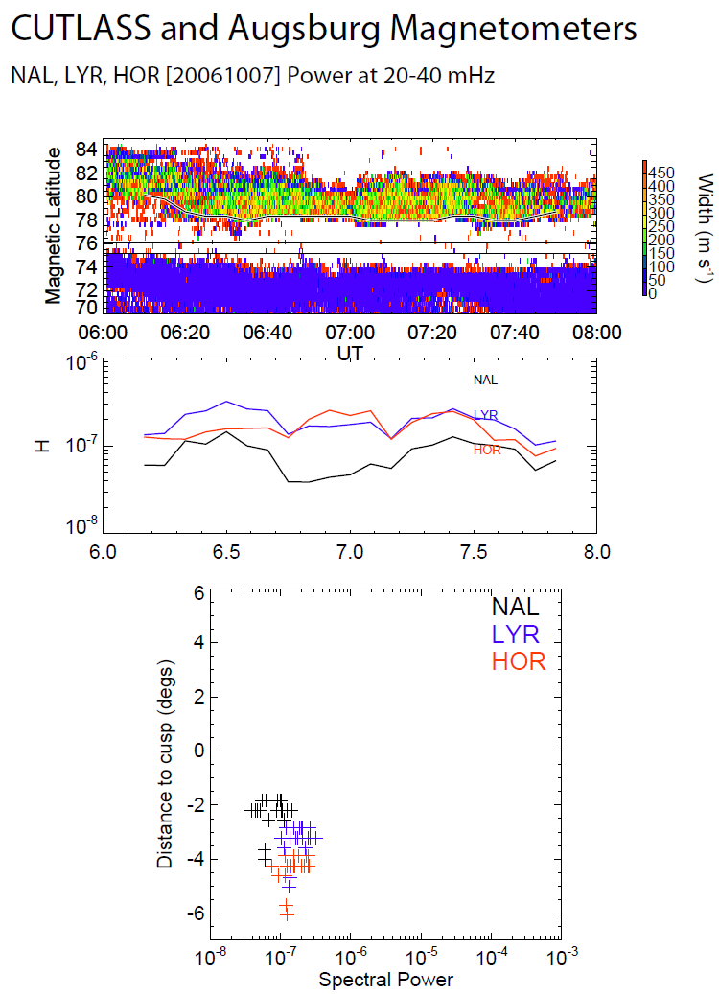
LYR largest at the beginning and end, when the cusp is at highest latitudes, HOR largest when cusp is at lowest latitudes
Peak power ~ 3 - 4° equatorward of cusp

Slide 9
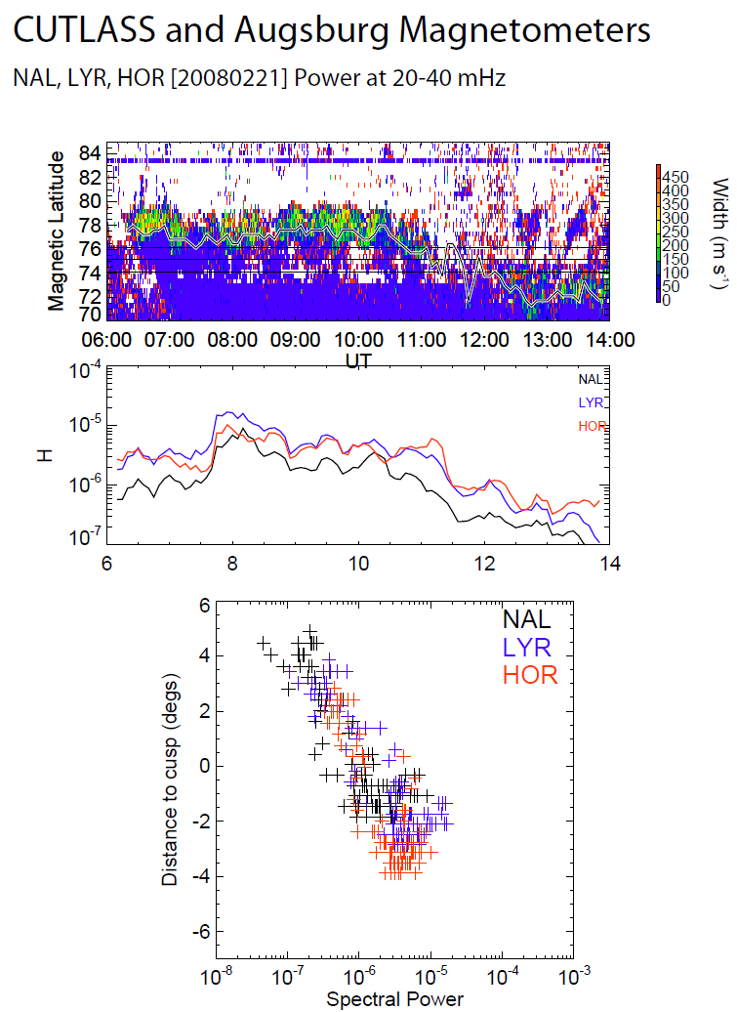
LYR largest at the beginning. HOR largest when cusp moves lower both when HOR is poleward and equatorward of the cusp
Peak power ~ 2° equatorward of cusp
Combine together 14 days with good Pc3 activity: 1364 data points for comparison

Slide 10
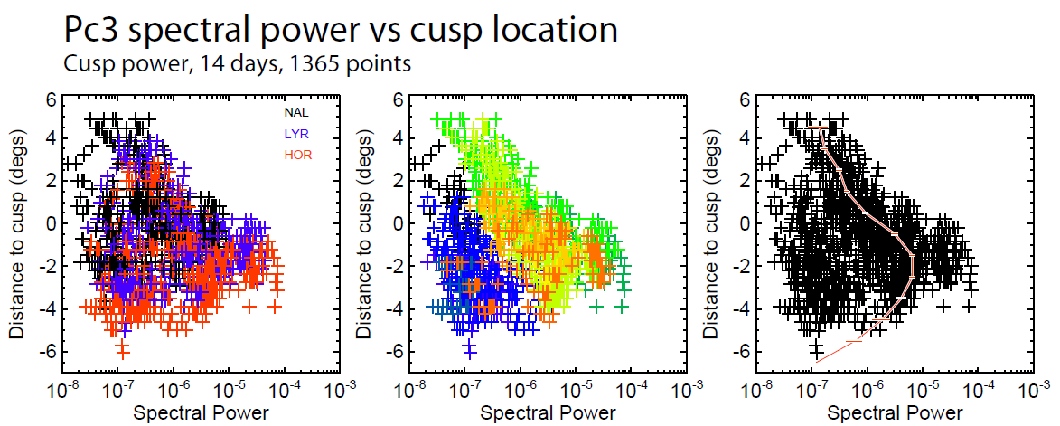

Slide 11
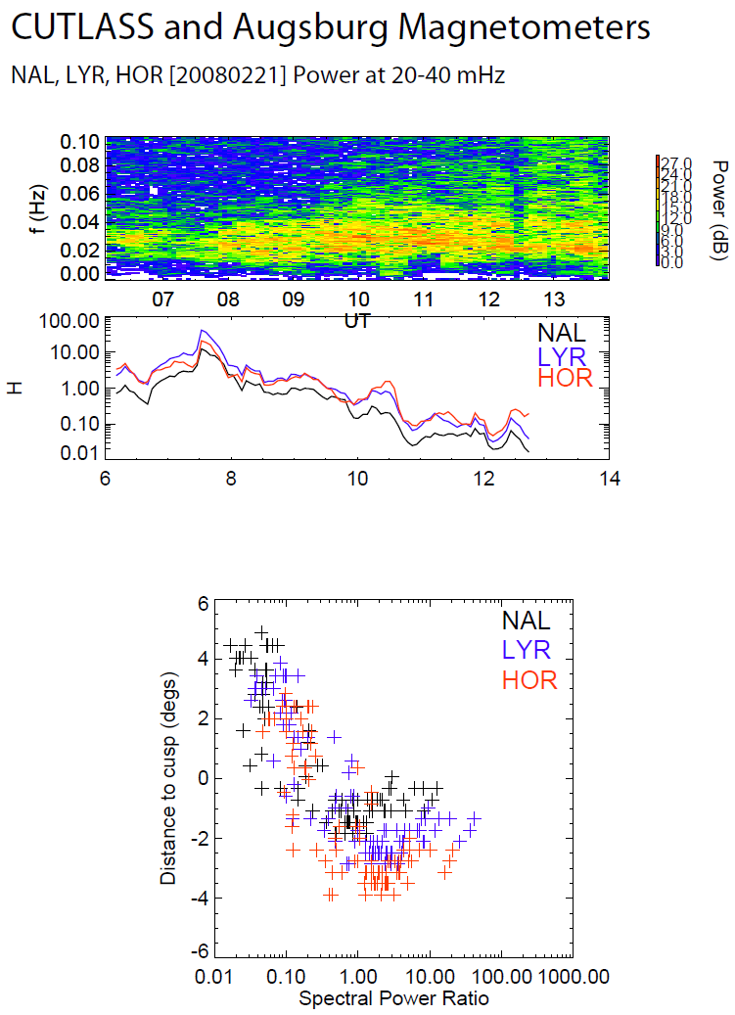
Upsteam wave power will very with time: normalise with power at Halley, well equatorward of the cusp

Slide 12
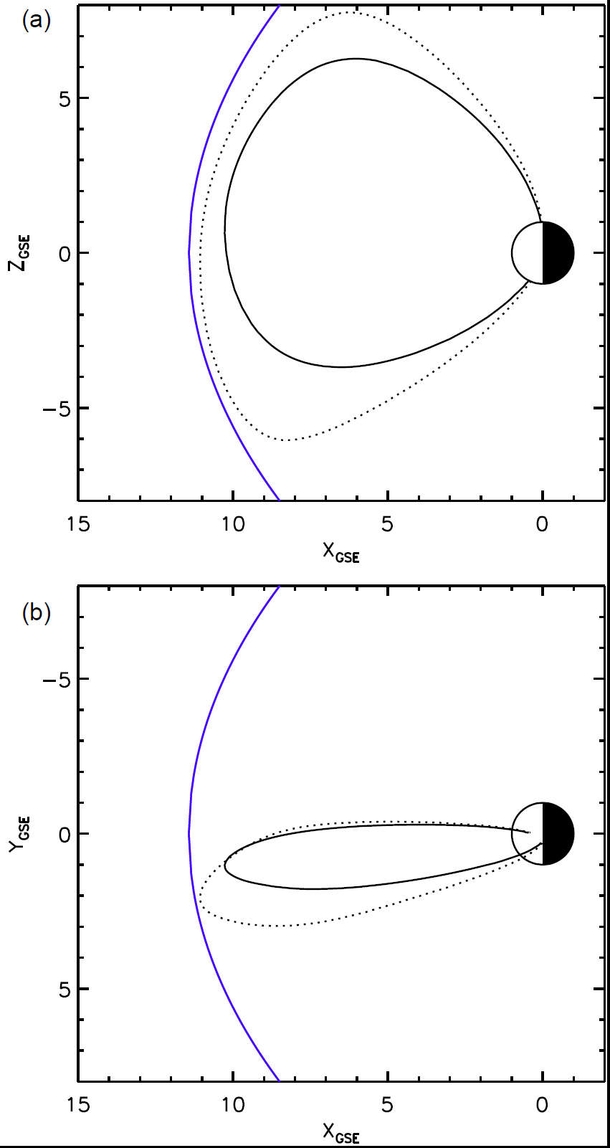
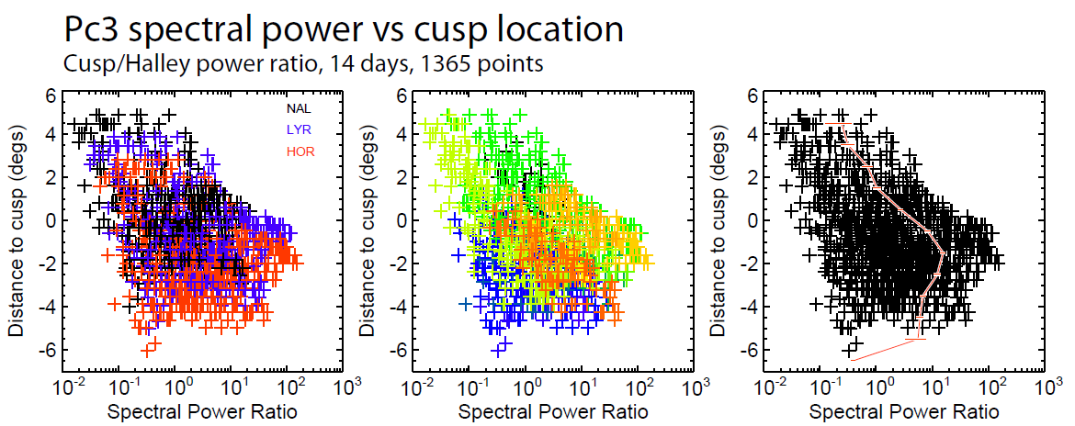

Slide 13
Conclusions
The CUTLASS Hankasalmi radar is an excellent diagnostic of the cusp location for use with the Augsburg magnetometer array on Svalbard
Pc3 ULF wave activity peaks ~2° equatorward of the cusp, rather than in the cusp itself.
Pc3 ULF wave activity can be seen to be modulated as the open-closed field line boundary, as predicted from the Hankasalmi radar data, migrates across the magnetometer array
Wave power occupies a fairly broad latitude range equatorward of the open-closed field line boundary, but drops sharply poleward of it. The spatial structure of the wave power within the magnetosphere seems to be as important as its temporal variability. Howard and Menk (2005) seem to have a point.

